Slide 1

Feature Engineering: Let’s talk about-
Types of Variables
Measure of Central Tendency
Encoding Techniques
Handle NaN Value
Implementing using Python
AAbu Bakar Siddique Mahi

Slide 2



Types of Variables in Data Science
Categorical
Numerical
Time Series
Nominal
Ordinal
Continuous
Dichotomous
Discrete
Time series

Slide 3

Categorical Data
Dichotomous
Ordinal
Nominal
Colors Names
Location Names
Car Names
Yes, No
Male, Female
Left, Right
Good >Average> Below
High> Medium> Low
Satisfied> Neutral> Dissatisfied

Slide 4

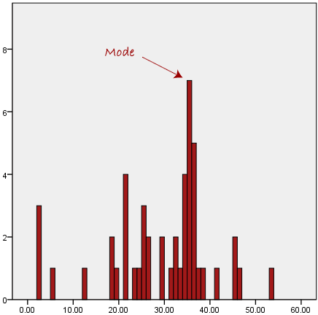
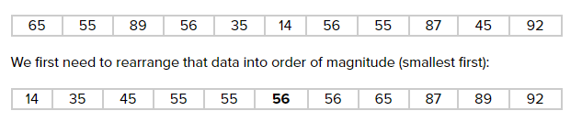
Measures of Central Tendency
K-Means Clustering
Mean: The mean is the most popular and well known
measure of central tendency.
Median: The median is the middle score for a set of data that has been arranged in order of magnitude.
Mode: The mode is the most frequent score in our
data set.

Slide 5
Encoding Techniques in Machine
l
What is encoding?
Why it is very important?

Slide 6
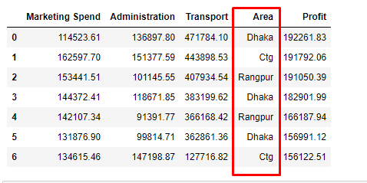
Encoding Techniques in Machine
l
Fig: Before Encoding

Slide 7
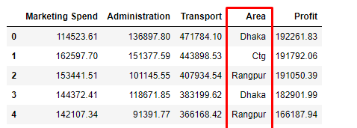
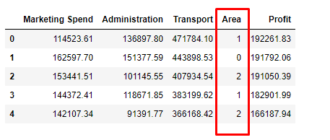
Encoding Techniques in Machine
Fig: Before Encoding
Fig: After Encoding

Slide 8
Encoding Techniques in Machine
Without Use Any Encoding Techniques
Label Encoding
One-Hot Encoding
Ordinal Encoding

Slide 9
Encoding Techniques in Machine
Without Use Any Encoding Techniques
Height
Tall
Medium
Short
Encoded
Height
2
4
6

Slide 10
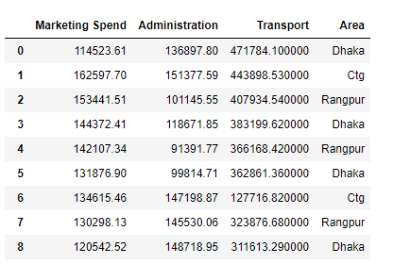
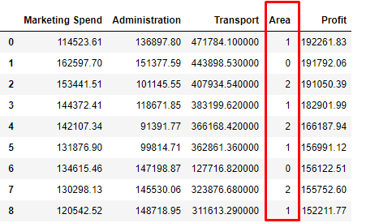
Label Encoding
K-Means Clustering

Slide 11
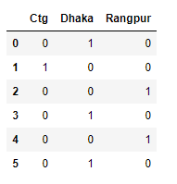
One-Hot Encoding
K-Means Clustering

Slide 12
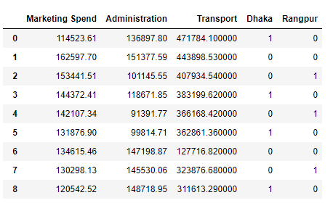
One-Hot Encoding
K-Means Clustering

Slide 13
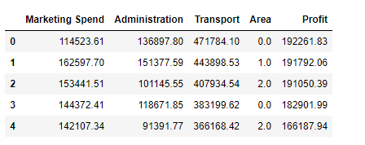
Ordinal Encoding
K-Means Clustering

Slide 14
Now, Let’s do it with PYTHON!

